Slide 1
Digital Wellbeing
Unit 13 - Project
By Aaron Mascarenhas

Slide 2
Introduction
This presentation will compare the statistical data form my primary and secondary research data which are collected from questionnaire in the form of google forms.
From recent research and draw conclusions based on the strength and weaknesses of the topic regarding “Are technology companies responsible for the health, safety and wellbeing of users?” In addition, I will elaborate more on the impact on how it affected the health and safety of users and the future of society.

Slide 3
Primary Research
This research method involves first hand collection of data which by an individual for analysis, study, research, or documentation of the collected information.
Questionnaire - This research involved getting data through questionnaires that were designed to get the customer's consent and approval to gather data form them for the purpose of the research
Google Forms - These are data forms which are collected from groups of people about a certain issue that bothers or might have issues with, and discuss a satisfying solution to resolve the issue.

Slide 4
Secondary Research
This research method involves second hand collection of data by an individual for analysis, study, research, or documentation of the collected information.
Data available online - These are data that are available online that can be used to support the research. Data gathered from different resources that are proven by experts and professionals in the field.
Public libraries - This is the most convenient method of research that is used to gather data for research which are filled with hundreds of books with research articles, documentations, journals, newspapers that are preserved from the past to be analysed.
Commercial information sources -These are commercial outlets that include newspapers, journals, magazines, radio and T.V stations are great resources and are used for reviews.

Slide 5
Charts and graphs
The data gathered for primary and secondary will be presented in the form of charts and graphs which will be compared side by side to show how they would be in terms of local verses compared to the rest of the world
This will demonstrate the digital wellbeing with more clear perspective to explore their function in a wider view.

Slide 6
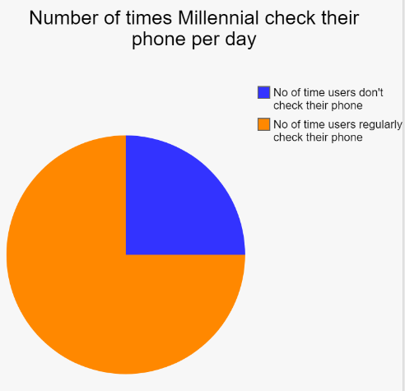
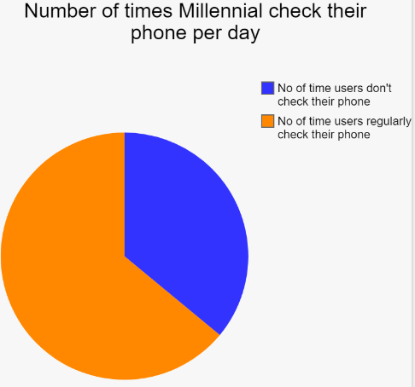
Checking phones per day
Primary Research
Secondary research
36% Number of times Millennials check their phone per day
64% Number of times Millennials check their phone per day

Slide 7
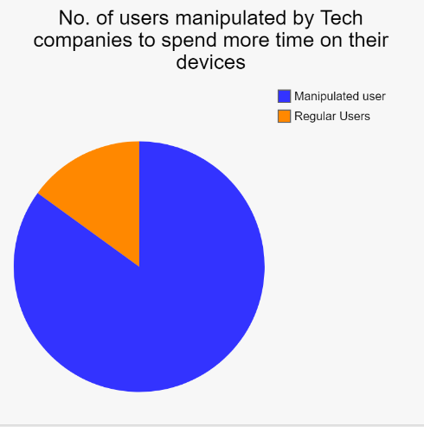
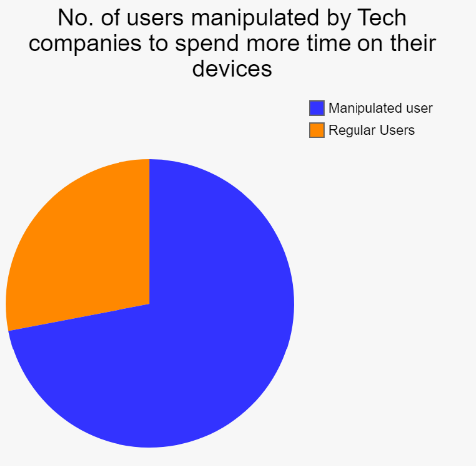
Tech Companies manipulate users
Primary Research
Secondary research
85% of teens believe tech companies manipulate users to spend more time on their devices
72% of teens believe tech companies manipulate users to spend more time on their devices

Slide 8
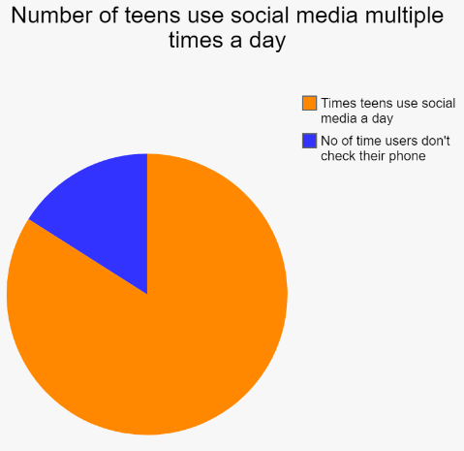
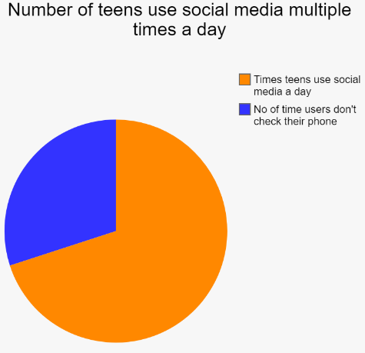
Social Media Usage
Primary Research
Secondary research
86% of teens use social media multiple times a day, with 14% saying they use it “almost constantly”
70% of teens use social media multiple times a day, with 16% saying they use it “almost constantly”

Slide 9
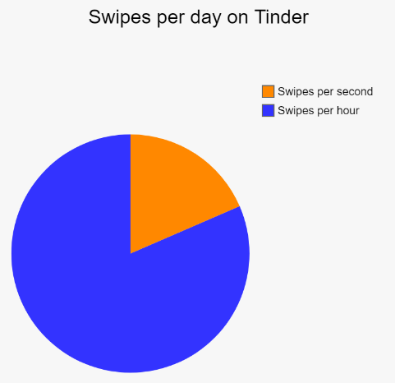
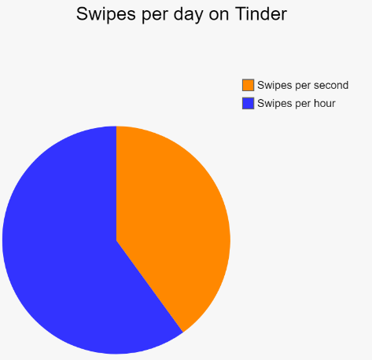
Tinder Swipes per day
Primary Research
Secondary research
1.6bn Swipes per day on Tinder alone. That’s more that 18,500 every second
1.6bn Swipes per day on Tinder alone. That’s more that 18,500 every second

Slide 10
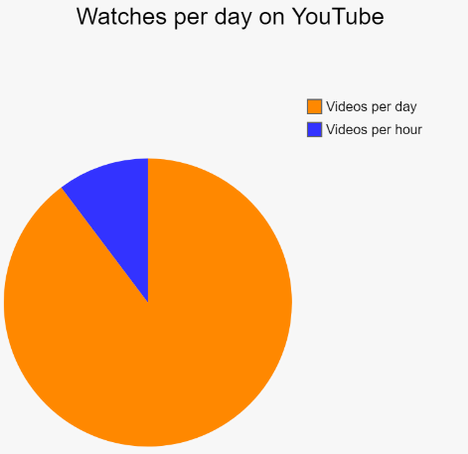
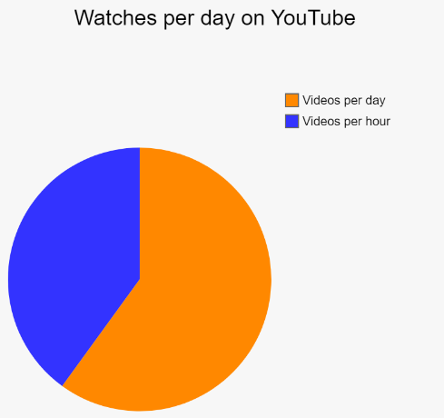
Users use Youtube per day
Primary Research
Secondary research
1.9 billion people use YouTube.
People in my area who use YouTube.

Slide 11

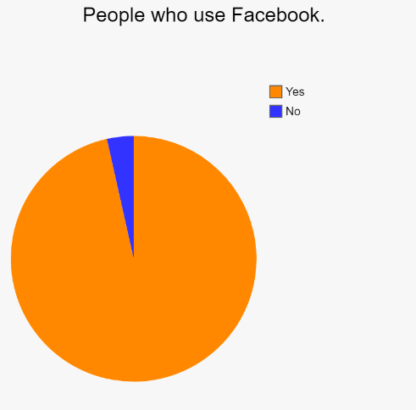
Users use Facebook
Primary Research
Secondary research
2.27 billion people use Facebook.
People in my area who use Facebook.

Slide 12
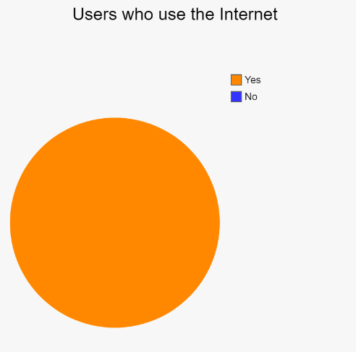
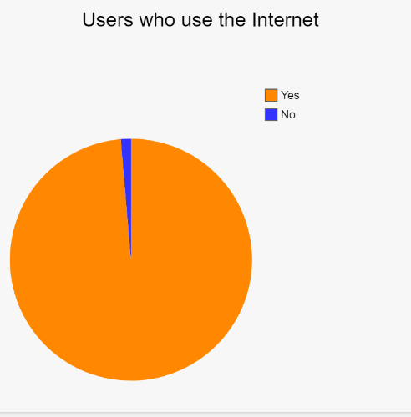
Users who use the Internet
Primary Research
Secondary research
4 billion people use the internet. That’s more than half the world’s population
People in my area who use the Internet.

Slide 13
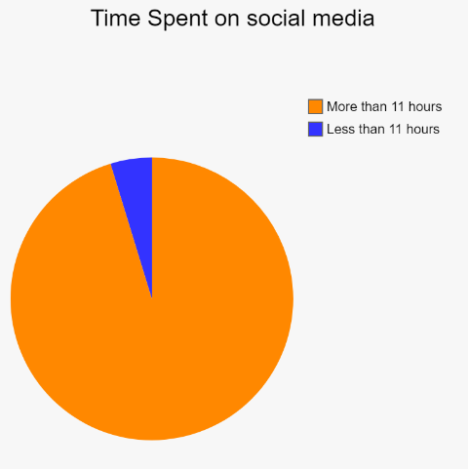
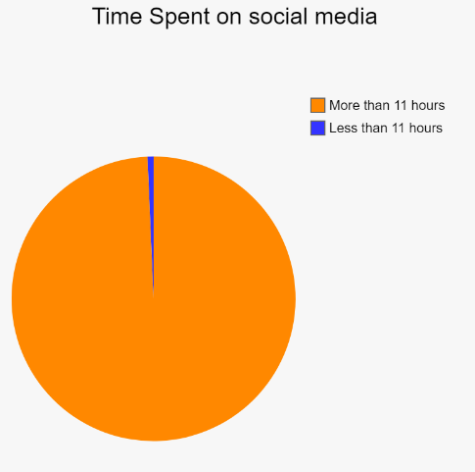
Time spent on social media
Primary Research
Secondary research
11 hours. The time adults spend everyday engaging with some form of media.
People in my area who spend time on social media.

Slide 14
Recommendations
The recommendation i would give based on the above primary and secondary research performed would be that digital wellbeing is growing more and more as users spend more time on their devices and seek for help to stay in control of their health.
Users should stay in control by implementing strict rules to follow to reduce the amount they spend on devices and find other things to distract them from their addictions and find new hobbies that they like.
Taking a break would greatly improve their lifestyle and motivate them to go outside and make meaningful relationships and conversations which would otherwise not be possible.
Users must take the first step in making a change in their daily habits by joining groups that move away from digital distractions and find other ways to interact with people.

Slide 15
Summary
This presentation will compared the statistical data form my primary and secondary research data which are collected from questionnaire in the form of google forms.
From recent researches and drawing conclusions based on the strength and weaknesses of the topic regarding “Are technology companies responsible for the health, safety and wellbeing of users?” In addition, I also elaborated more on the impact on how it affected the health and safety of users and the future of society.

